Slide 1

How to Save a Million Lives Series: Part 1
Transforming Care for Tri-diagnosis Patients
Paul Lynch, MD
Founder and CEO, US Pain Care
Email: LynchMD@gmail.com
Cell: 480-310-3878

Slide 2
Concept of Tri-Diagnosis
Mental Illness
Substance Abuse
Chronic Pain Condition
Dual diagnosis is a term utilized in psychiatry to define patients with co-existing mental illness and substance abuse
Recent health economic data has noted the prevalence of patients with dual diagnosis in conjunction with a chronic health condition. These patients represent a significant economic burden on the healthcare system.
We have coined the term “tri-diagnosis” to identify these patients. In our population, the chronic health condition our patients face is a chronic pain condition

Slide 3
Case Study: National Medicaid Data
  National study reported the 3.6% of Medicaid enrollees with annual per-beneficiary costs greater than $25,000 consumed nearly 50% of total Medicaid spending
  A study of California’s Medicaid beneficiaries found that the state had more than 1,000 super users who each incurred costs of more than $100,000 in 2004. To be clear, these 1,000 super users incurred costs of $100 million in a single year.
Corporation for Supportive Housing. Frequent Users of Emergency Departments: Addressing the Needs of a Vulnerable Population in a Medicaid Waiver. July 2009

Slide 4
Case Study: Integrated Care Collaboration
Data collected in Austin, Texas, from 2003 to 2008
Found that just 9 patients made 2,678 visits to Austin-area ERs in a 6-year period, incurring costs of more than $3 million.
One patient made 145 visits to the ER in the last year of the study
Texas E.R. Patients Account for Nearly 2,700 Emergency Room Visits, April 1, 2009. Available at http://officerresource.com/forums/f5/9-texas-e-rpatients-account-nearly-2-700-emergency-room-visits-35051

Slide 5
Case Study: Commercial Payer in Texas
Payer identified 35,000 chronic pain patient members that qualified as super users (identified by frequent ER visits, high volume of physician visits and prescriptions)
Payer noted they were spending an average of $3,000 per month on each of these super users
Resulting in a 1.26 billion annual spend, representing nearly 11% of the TOTAL yearly spend in Texas, for less than 0.6% of the total members

Slide 6
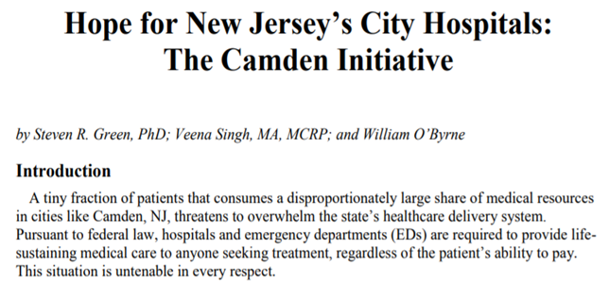
Case Study: The Camden Initiative
Analyzed medical claims data for the 3 hospitals and ERs in Camden from 2002 to 2007, examining 387,000 records for 98,000 patients
80% of the total cost for treating 98,000 patients was generated by only 13% of those patients. The authors of the paper referred to these patients as “super users”
The common denominator repeatedly noted in this patient population was the presence of tri-diagnosis: a chronic heath condition, mental illness, and substance abuse

Slide 7
Case Study: The Camden Initiative
In 2007, based upon the results of the data, they piloted a case management program, with a nurse practitioner, social worker, and community health worker assigned to each patient.
The case management team provided medical care, access to community resources (including obtaining health insurance, housing, food, medications etc.), and emotional support to the patient at their homes, in homeless shelters, and sometimes on the street.
Results of the program:
  56% reduction in hospital charges
  40% reduction in ER visits

Slide 8
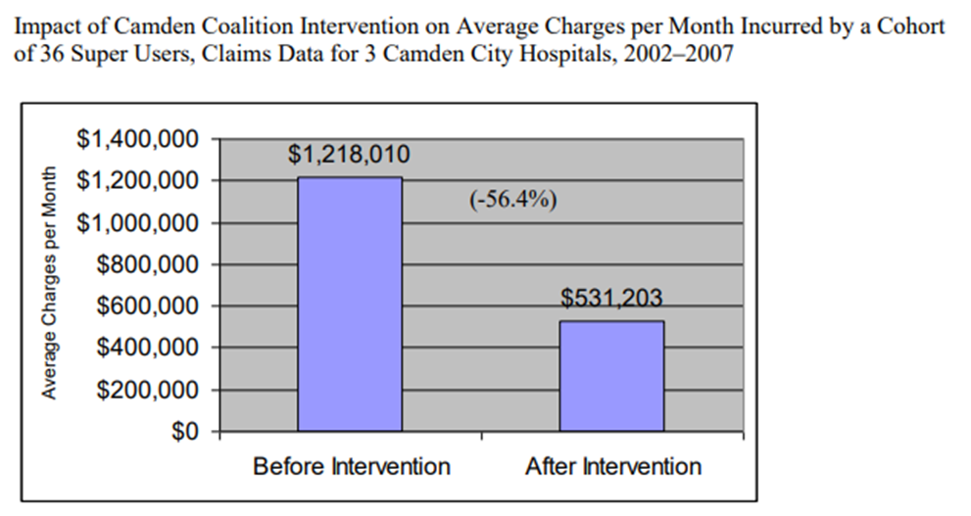
Case Study: The Camden Initiative

Slide 9
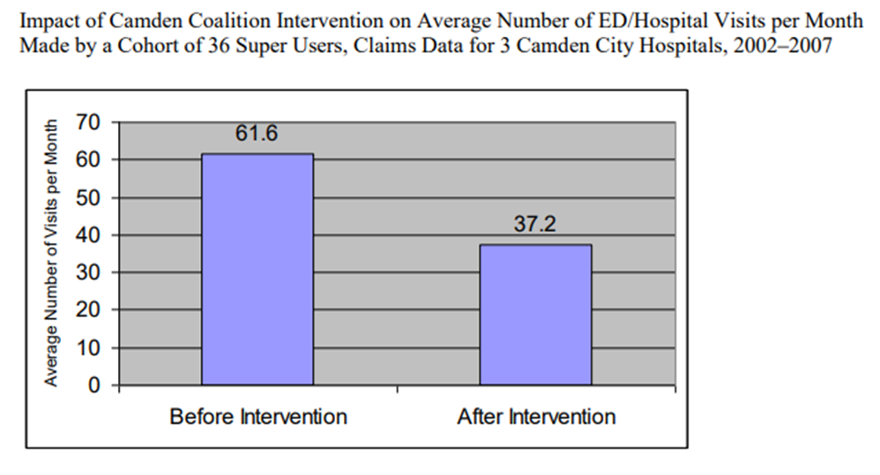
Case Study: The Camden Initiative

Slide 10
Case Study: California Initiative
  Study of case management intervention on 53 patients who used the ER five times or more in 12 months in the San Francisco area
  Patients were assigned to a case manager who was responsible for providing and coordinating the following services:
    crisis intervention
    individual and group therapy
    arrangement of stable housing
    linkage to PCPs
    referral to substance abuse treatment
    extensive, persistent outreach via home visits and accompanying patient to appointments
Okin, R. L., A. Boccellari, F. Azocar, M. Shumway, K. O’Brien, A. Gelb, M. Kohn, P. Harding, and C. Wachsmuth. ―The Effects of Clinical Case Management on Hospital Service Use among ED Frequent Users. American Journal of Emergency Medicine 18, no. 5 (2000): 603–8.

Slide 11
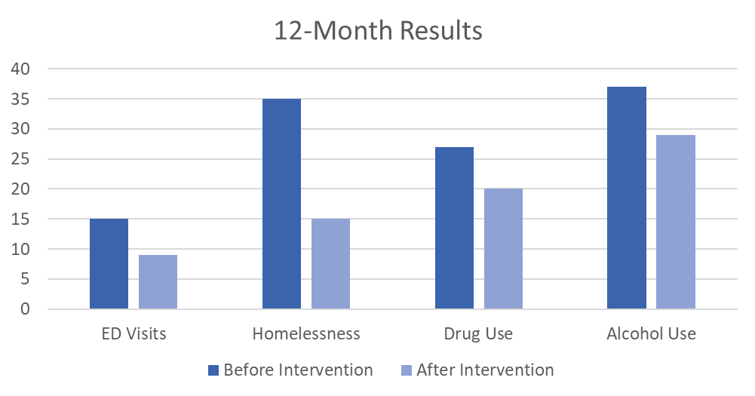
Case Study: California Initiative
Okin, R. L., A. Boccellari, F. Azocar, M. Shumway, K. O’Brien, A. Gelb, M. Kohn, P. Harding, and C. Wachsmuth. ―The Effects of Clinical Case Management on Hospital Service Use among ED Frequent Users. American Journal of Emergency Medicine 18, no. 5 (2000): 603–8.

Slide 12
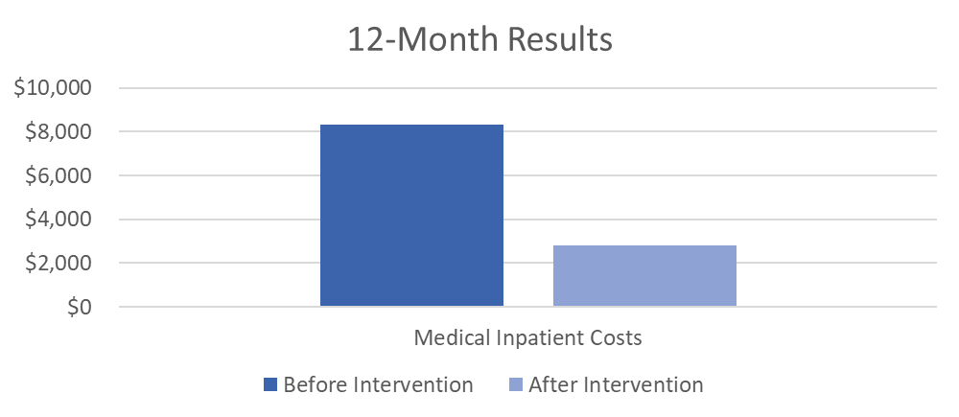
Case Study: California Initiative
66% reduction in medical inpatient costs
Okin, R. L., A. Boccellari, F. Azocar, M. Shumway, K. O’Brien, A. Gelb, M. Kohn, P. Harding, and C. Wachsmuth. ―The Effects of Clinical Case Management on Hospital Service Use among ED Frequent Users. American Journal of Emergency Medicine 18, no. 5 (2000): 603–8.

Slide 13
Case Study: California Initiative
66% reduction in medical inpatient costs
Okin, R. L., A. Boccellari, F. Azocar, M. Shumway, K. O’Brien, A. Gelb, M. Kohn, P. Harding, and C. Wachsmuth. ―The Effects of Clinical Case Management on Hospital Service Use among ED Frequent Users. American Journal of Emergency Medicine 18, no. 5 (2000): 603–8.

Slide 14
Intensive Outpatient Program (IOP) Overview
Comprehensive, multidisciplinary program focused on patients with tri-diagnosis: substance abuse, mental illness, and chronic pain. These patients represent the most complex and difficult to treat population.
Ten-week intensive outpatient model with close ongoing follow up thereafter to ensure continuing reduction in costs
Inclusive of comprehensive pain management, diagnostic services, medical management, MAT, multifaceted hands-on therapy, behavioral health, and addiction treatment
Coordination of care and patient engagement with the use of an advanced case management department
Addressing home disposition, employment status, and other social/environmental barriers patient may be facing

Slide 15
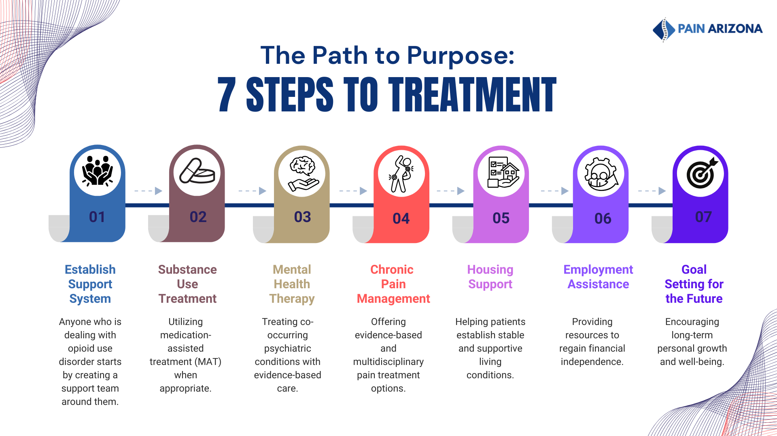

Slide 16
IOP Case Management
Each patient will be assigned a case manager who is responsible for engaging and guiding the patient through the program
The goal of case management is to coordinate care among all service lines and ensure the patient is engaged and adhering to the program

Slide 17
IOP Stages of Treatment
Stage One: Diagnosis (weeks 1 to 3)
Upon engagement with the program, the patient will undergo a full intake and assessment with a pain management provider, psychiatric provider, and addictionologist to develop a treatment plan for each specific diagnosis (chronic pain condition, mental illness, and substance abuse).
Pursue diagnostics (such as MRI, EMG, etc.) to identify the root of the patient’s chronic pain condition and develop an appropriate plan to address.
Integration and input from each department is necessary for optimal treatment plans and associated patient outcomes and is facilitated by the case manager

Slide 18
IOP Stages of Treatment
Stage Two: Stabilization (weeks 4 to 8)
Medical management: comprehensive chronic pain treatment program will be initiated, including medication management and interventional procedures if necessary
Behavioral health: medical management of psychiatric conditions, CBT, biofeedback, family therapy, and support groups
Addiction treatment: psychological treatment, outpatient detox services, and MAT
Hands-on therapy: multifaceted hands-on therapy including physiotherapy, massage, yoga, tai chi, manipulation, acupuncture, diet and exercise education, home exercise, bracing, TENS units, and ultrasound therapy

Slide 19
IOP Stages of Treatment
Stage Three: Transition (weeks 9 to 10)
Setting goals for future: dream again
Support from case manager to ensure patient is engaged and participating in the program, as well as ensuring patient has appropriate tools for continued success following completion of the intensive program
Focused care from the case manager will be essential to a successful transition into normal daily life
Partnership with community health care workers to focus on housing, social, and environmental support

Slide 20
IOP Stages of Treatment
Stage Four: Follow Up (week 10 and beyond)
Following completion of the ten-week intensive program, ongoing follow up will occur with 2x per month with outreach from the case manager, via phone, or in-person
Many of these patients will continue to be seen monthly for their chronic pain condition or MAT. This will allow additional touchpoints for the case management team to meet with patient in person.
This will continue for the first three years following the program

Slide 21
Opioid Use Disorder Prevalence
3.7% of adults (age 18+) in the US need OUD treatment (9.7 million)
3.6% of adolescents (age 12-17) in the US need OUD treatment (900,000)
This equates to 10.6 million individuals who need OUD treatment
Treatment for Opioid Use Disorder: Population Estimates — United States, 2022 | MMWR

Slide 22
Opioid Use Disorder Prevalence
The need for OUD treatment increases with poverty level:
      5% for among those with income 100-199% of the poverty level
    7.5% among person with income <100% of the poverty level
Treatment for Opioid Use Disorder: Population Estimates — United States, 2022 | MMWR

Slide 23

Opioid Use Disorder Prevalence
An estimated 233,000 Arizonians need OUD treatment

Slide 24
Opioid Use Disorder Prevalence
Only 55% of these individuals will receive OUD treatment
Only 25% of those who receive treatment will receive medication-assisted treatment
Treatment for Opioid Use Disorder: Population Estimates — United States, 2022 | MMWR

Slide 25
Questions?
  Paul Lynch, MD
  Founder and CEO, US Pain Care
  Email: LynchMD@gmail.com
  Cell: 480-310-3878

