Slide 1

How to Save a Million Lives Series: Part 2
Medication Assisted Treatment and Buprenorphine Micro Induction
Paul Lynch, MD
Founder and CEO, US Pain Care
Email: LynchMD@gmail.com
Cell: 480-310-3878

Slide 2
Buprenorphine Pharmacology
Complex pharmacology, with mixed agonist and antagonist functions
Unique actions allow for analgesia and management of withdrawal symptoms, while also minimizing side effects and risks of traditional opioids
Schedule III controlled substance, all formulations are long-acting

Slide 3
Buprenorphine Pharmacology
Binds to all four opioid receptors
  Acts as an antagonist
  Mediates analgesic, dysphoric, and psychotomimetic effects
  Acts as a partial agonist
  Mediates the rewarding and analgesic effects of opioids
Kappa-opioid receptor
Mu-opioid receptor
  Acts as an agonist (with lower affinity)
  Mediates the rewarding and analgesic effects of opioids (similar to mu receptor)
Delta-opioid receptor
  Acts as an antagonist
  Mediates mood regulation
Opioid receptor-like 1
Notes:
Psychotomimetic effects: hallucinations and delusions occurring in a normal individual

Slide 4
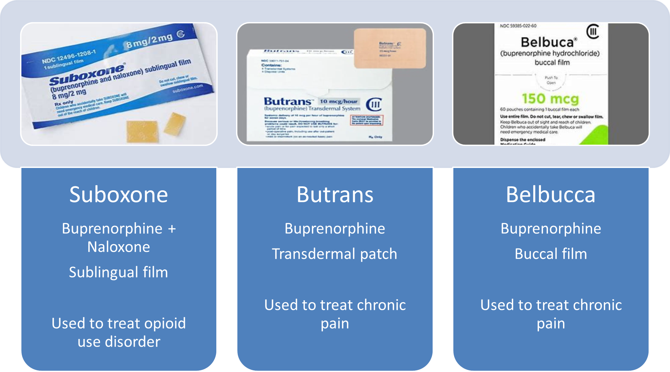
Buprenorphine Formulations
FDA approved indications: opioid detoxification, treatment of opioid use disorder, and pain management
Notes:
Suboxone: starting dose 2-4mg, maintenance dose 12-16mg, max dose 24mg
Butrans: starting dose 5-10mcg (if patient is opioid naïve start lower, higher dose for patients previously on opioids), average dose: 5mcg-20mcg, max dose 20mcg
Belbucca: starting dose and average dose is dependent upon previous opioid use, but ranges from 75mcg qd to 300mg BID, max dose 900mcg BID

Slide 5
Treatment Regulations for Buprenorphine
The Consolidated Appropriations Act of 2023 fully repealed all DATA waiver (also known as the X-waiver) requirements, including the patient limits
Now, all providers with a DEA license can prescribe buprenorphine for the treatment of OUD to an unlimited number of patients
It did separately add the need for providers to complete a total of 8 hours of training on opioid or other substance use disorders when renewing or newly applying for DEA registration

Slide 6
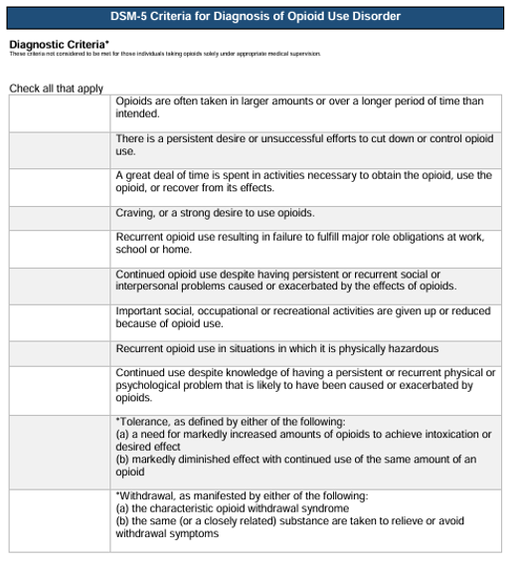
Criteria for Diagnosing OUD

Slide 7
Criteria for Diagnosing OUD

Slide 8
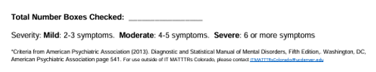
Criteria for Diagnosing OUD

Slide 9
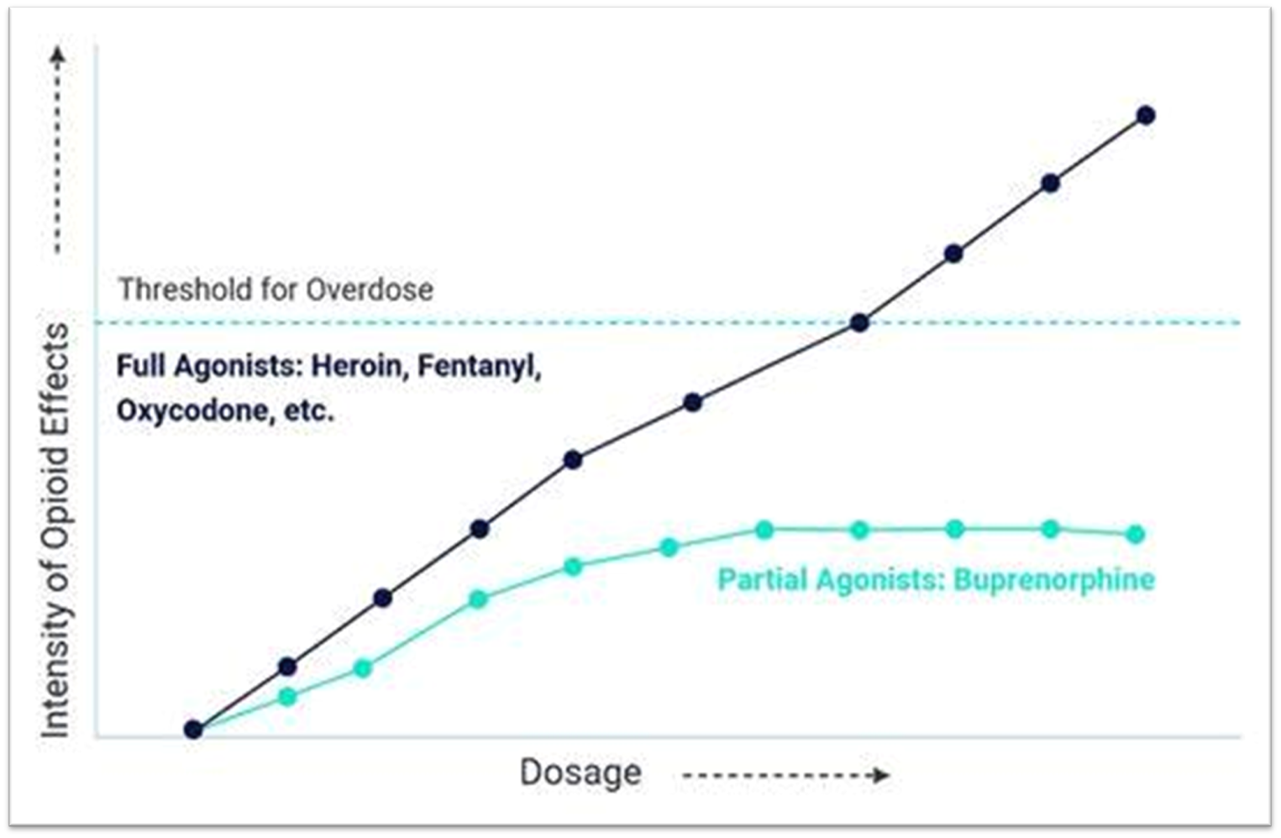
Ceiling Effect
Traditional opioids have a dose-dependent respiratory depression response, with apnea at high doses. Buprenorphine has a plateau effect, with research noting single doses of buprenorphine up to 70 times the recommended analgesic dose are well tolerated by human subjects.

Slide 10
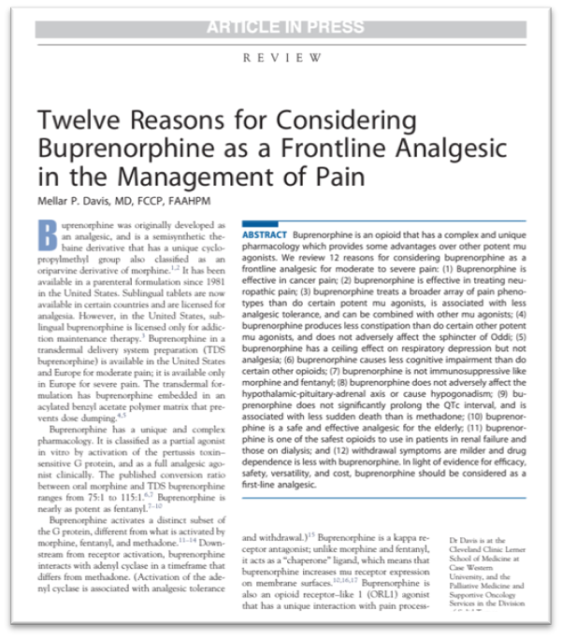
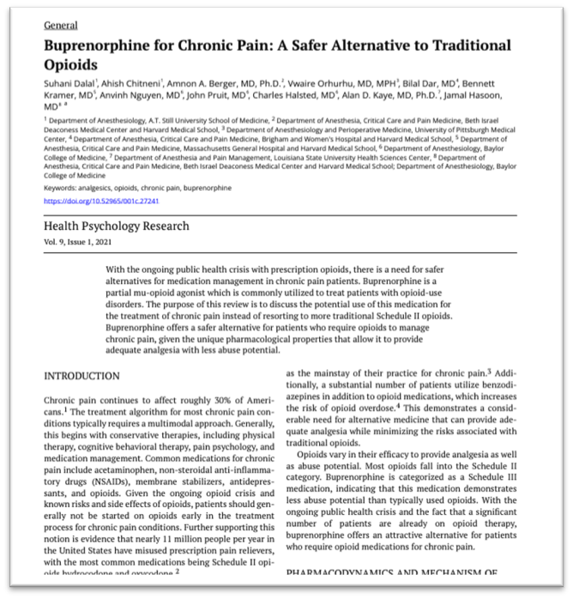
Benefits of Buprenorphine Therapy
Advantages for pain management:
  Increased efficacy for neuropathic pain
    Reduces the hypersensitivity and hyperalgesia associated with neuropathic pain
  Ease of use in elderly patients and those with renal impairment
  Less immunosuppression
  Decreased development of tolerance

Slide 11
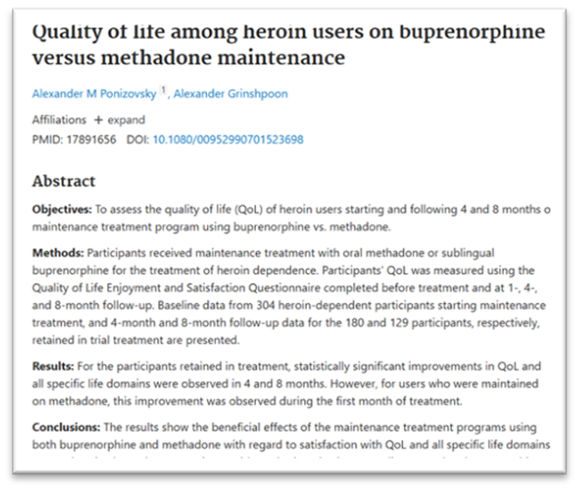
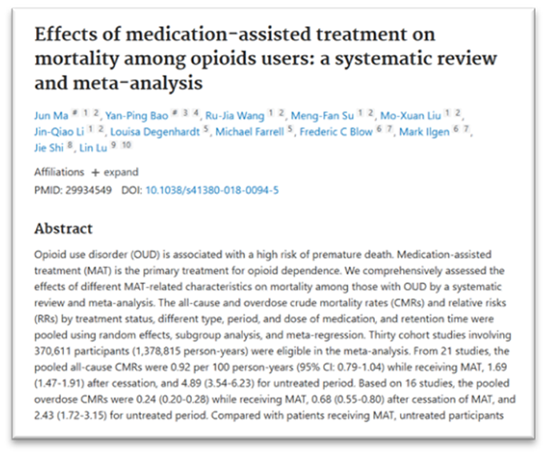
Benefits of Buprenorphine Therapy
Advantages for OUD treatment:
  Estimated mortality reduction of approximately 50% among people with OUD
  Improved social functioning
  Decreased injectable drug use and associated infectious diseases
  Better quality of life than those not in treatment
  Reduced levels of crime

Slide 12
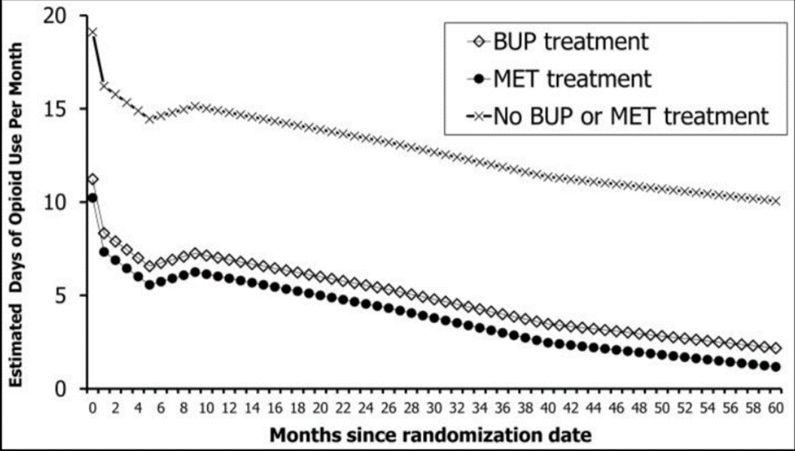
Benefits of Buprenorphine Therapy
Relapse and retention rates for MAT
Hser YI, Evans E, Huang D, et al. Long-term outcomes after randomization to buprenorphine/naloxone versus methadone in a multi-site trial. Addiction. 2016;111(4):695-705

Slide 13
Benefits of Buprenorphine Therapy
Weiss, R. D., & Rao, V. (2017). The prescription opioid addiction treatment study: what have we learned. Drug and alcohol dependence, 173, S48-S54

Slide 14
Buprenorphine vs. Methadone
Buprenorphine
Partial agonist of mu-opioid receptor
Can be prescribed for OUD by any practitioner with a DEA license
36–48-hour half life
Ceiling effect limits overdose risk
Less abuse potential
Mild withdrawal symptoms
Methadone
Full agonist of mu-receptor
Can only be prescribed/dispensed for OUD at an outpatient treatment facility
24–36-hour half life
No protective overdose factors
Greater abuse potential
Moderate to severe protracted withdrawal

Slide 15
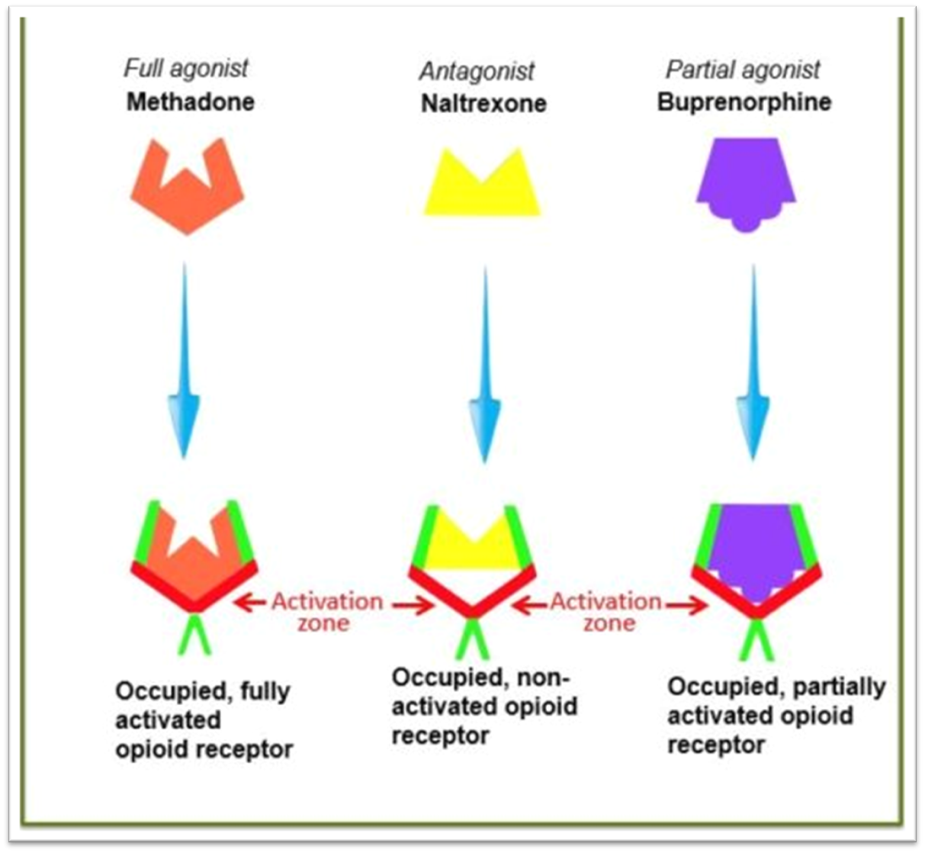
Buprenorphine vs. Methadone vs. Naltrexone
https://truthpharm.org/addiction-treatment/medicated-assisted-therapy/

Slide 16
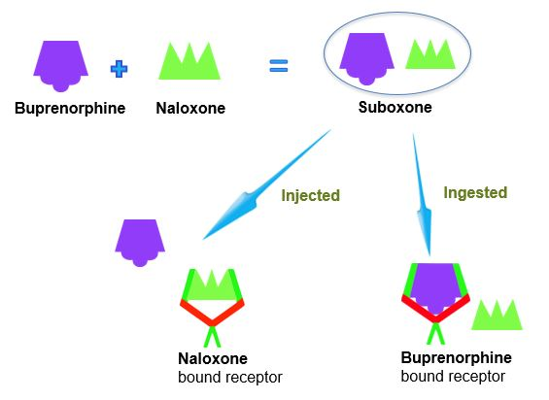
Suboxone (Buprenorphine + Naloxone)
Naloxone has a very low bioavailability when taken sublingually
As such, when Suboxone is taken correctly (as a sublingual tablet or film), only the buprenorphine become active and bioavailable, while the naloxone will remain inactive and not exert a clinical effect
However, if Suboxone is used by other means (IV, intranasal, inhaled), the naloxone is actively absorbed and acts as an antagonist at the receptor
https://truthpharm.org/addiction-treatment/medicated-assisted-therapy/

Slide 17
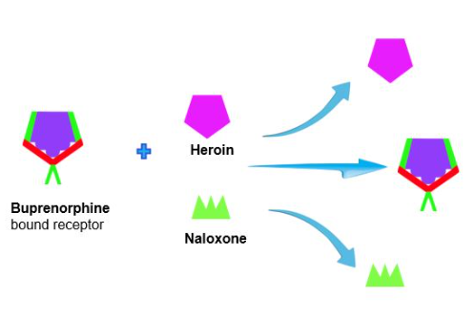
Suboxone (Buprenorphine + Naloxone)
Neither morphine (heroin) or naloxone can displace buprenorphine from the receptor once it is bound
As such, if heroin or other opioids are used when buprenorphine is bound, it will not exert any clinical effect
However, this blockade is dependent upon the dose of buprenorphine, and can be offset by high doses of full opioid agonists
https://truthpharm.org/addiction-treatment/medicated-assisted-therapy/
Notes:
Buprenorphine affinity for the mu opioid receptor is approximately 1.7 times that of hydromorphone, 5.4 times that of morphine, 6.2 times that of fentanyl, and 120 times that of oxycodone

Slide 18
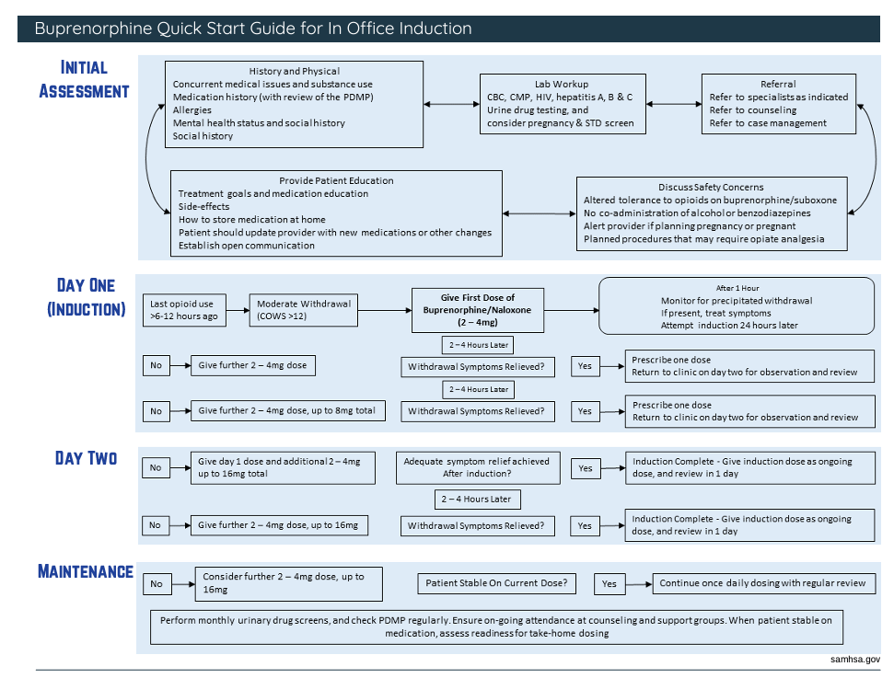
Buprenorphine Quick Start Guide

Slide 19
Buprenorphine Quick Start Guide

Slide 20
Buprenorphine Quick Start Guide

Slide 21
Buprenorphine Quick Start Guide

Slide 22
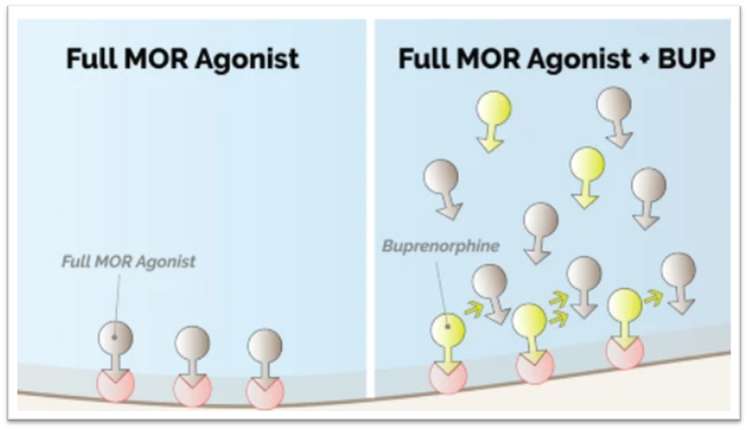
Buprenorphine Microdosing
The high-binding affinity of buprenorphine to the mu-receptor can cause precipitated withdrawal in patients currently taking full agonist opioids
Traditional guidance requires patients to abstain from full opioid agonists for 24-48 hours and be in moderate withdrawal before initiating buprenorphine for OUD
Microdosing is a novel approach that avoids withdrawal symptoms
De Aquino, J.P., Parida, S. & Sofuoglu, M. The Pharmacology of Buprenorphine Microinduction for Opioid Use Disorder. Clin Drug Investig 41, 425–436 (2021). https://doi.org/10.1007/s40261-021-01032-7

Slide 23
Buprenorphine Microdosing
Process for microdosing:
Initiate low dose of buprenorphine (typically less than 1mg). Patient may continue the use of their full opioid agonist
Gradually increase the buprenorphine (typically over the course of 7 to 14 days) until a therapeutic dose is achieved
Once a therapeutic dose is reached, the full-opioid agonist can be promptly discontinued (no need to taper)

Slide 24
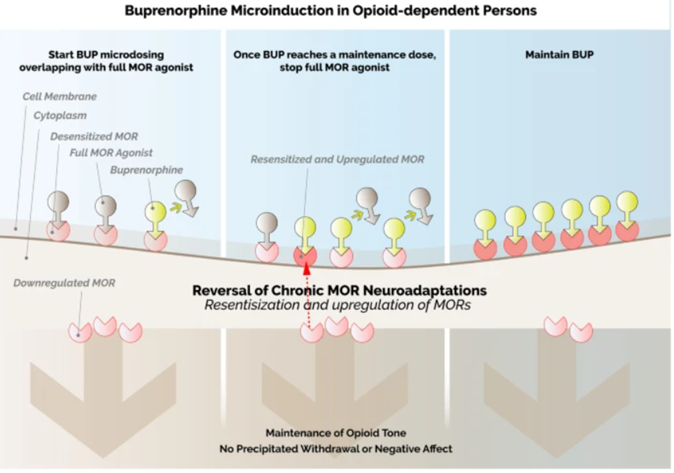
Buprenorphine Microdosing
De Aquino, J.P., Parida, S. & Sofuoglu, M. The Pharmacology of Buprenorphine Microinduction for Opioid Use Disorder. Clin Drug Investig 41, 425–436 (2021). https://doi.org/10.1007/s40261-021-01032-7

Slide 25
Buprenorphine Microdosing
Sample schedule, patient on a short-acting opioid:
Day | Buprenorphine | Opioid
1 | 0.5mg QD | Maintain dose
2 | 1.0mg QD | Maintain dose
3 | 1.5mg QD | Maintain dose
4 | 2.0mg QD | Maintain dose
5 | 2.5mg QD | Maintain dose
6 | 3.0mg QD | Maintain dose
7 | 4.0mg QD | Discontinue
Following day 7, you may continue to increase the buprenorphine dose by 2-4mg per day until a therapeutic dose is reached

Slide 26
Buprenorphine Microdosing
Day | Buprenorphine | Opioid
1 | 0.5mg QD | Maintain dose
2 | 1.0mg QD | Maintain dose
3 | 1.5mg QD | Maintain dose
4 | 2.0mg QD | Maintain dose
5 | 2.5mg QD | Maintain dose
6 | 3.0mg QD | Maintain dose
7 | 4.0mg QD | Maintain dose
If patient is on a short-acting and long-acting, the short-acting may be discontinued here
8 | 5.0mg QD | Maintain dose
9 | 6.0mg QD | Maintain dose
10 | 7.0mg QD | Maintain dose
11 | 8.0mg QD | Maintain dose
12 | 10.0mg QD | Maintain dose
13 | 12.0mg QD | Discontinue long-acting
Sample schedule, patient on a long-acting opioid

Slide 27
Buprenorphine for OUD Dosing
Buprenorphine daily dose following induction and titration is generally >8mg, with an average daily dose of 12-16mg
The FDA approves doses up to 24mg per day, and there is limited evidence on the efficacy of doses above 24mg per day

Slide 28
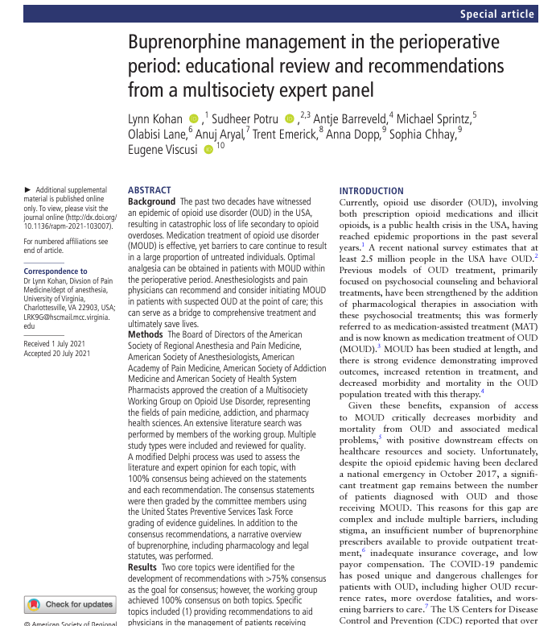
Buprenorphine and Surgery
ASA and ASRA published a joint perioperative management guideline for buprenorphine in 2021
Overall, they recommend that buprenorphine is NOT discontinued or tapered during the perioperative period, rather have the patient continue their usual dose without interruption

Slide 29
Buprenorphine and Surgery
ASA and ASRA published a joint perioperative management guideline for buprenorphine in 2021
Overall, they recommend that buprenorphine is NOT discontinued or tapered during the perioperative period, rather have the patient continue their usual dose without interruption

Slide 30
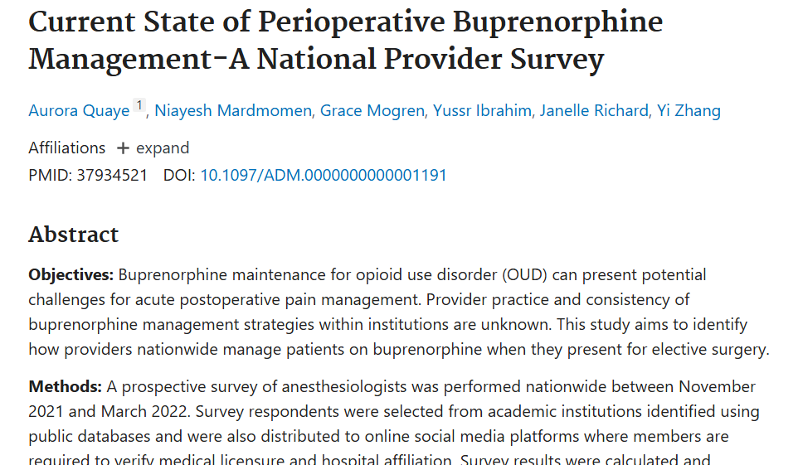
Buprenorphine and Surgery
Despite these guidelines, a 2022 survey noted that only 36% of institutions reported an established protocol for perioperative management of buprenorphine, with significant discrepancy in how buprenorphine is managed for surgeries with moderate to severe pain
Patients with OUD may fear receiving adequate pain relief, experiencing opioid withdrawals, and relapsing if MAT is tapered or discontinued during the perioperative period

Slide 31
Buprenorphine and Polysubstance Use
The American Society of Addiction Medicine (ASAM) Practice Guidelines state the following regarding MAT for OUD:
The use of marijuana, stimulants, or other addictive drugs should not be a reason to suspend OUD treatment. However, evidence demonstrates that patients who are actively using substances during OUD treatment have a poorer prognosis.
However, the use of alcohol, benzodiazepines, and other sedative hypnotics may be a reason to suspend MAT treatment due to safety concerns related to respiratory depression

Slide 32
Questions?
  Paul Lynch, MD
  Founder and CEO, US Pain Care
  Email: LynchMD@gmail.com
  Cell: 480-310-3878

